Slide 1

UNIVERSITY INSTITUTE OF ENGINEERING
COMPUTER SCIENCE ENGINEERING
Master of Engineering
ADVANCED DATA STRUCTURES
&
ALGORITHMS
(23CSH-622)
INTRODUCTION
DISCOVER . LEARN . EMPOWER

Slide 2

ADVANCED DATA STRUCTURES
&
ALGORITHMS
(23CSH-622)
By : Dr. Ranjit Singh (E10947)
www. cuchd.in Campus : Gharaun, Mohali

Slide 3
DYNAMIC ARRAYS
Course Outcome
Will be covered in this lecture
CO Number | Title | Level
CO1 | To understand role of algorithms in science and practice of computing.. | Remember
CO2 | To gain familiarization with different algorithm design techniques. | Understand
CO3 | To apply different algorithm design techniques for solving engineering and related problems and study their performance. | Analysis and application

Slide 4
TOPICS TO BE COVERED
Dynamic arrays
Need for Dynamic arrays
Difference between Array and Dynamic arrays.

Slide 5
DYNAMIC ARRAYS
automatic resizing
One limitation of arrays is that they're fixed size
dynamic array expands as you add more elements.

Slide 6
ADVANTAGES
Fast lookups. Just like arrays, retrieving the element at a given index takes O(1) time.
Variable size. You can add as many items as you want, and the dynamic array will expand to hold them.
Cache-friendly. Just like arrays, dynamic arrays place items right next to each other in memory, making efficient use of caches.

Slide 7
DISADVANTAGES
Slow worst-case appends. Usually, adding a new element at the end of the dynamic array takes O(1) time. But if the dynamic array doesn't have any room for the new item, it'll need to expand, which takes O(n) time.
Costly inserts and deletes. elements are stored adjacent to each other. So adding or removing an item in the middle of the array requires "scooting over" other elements, which takes O(n) time.

Slide 8
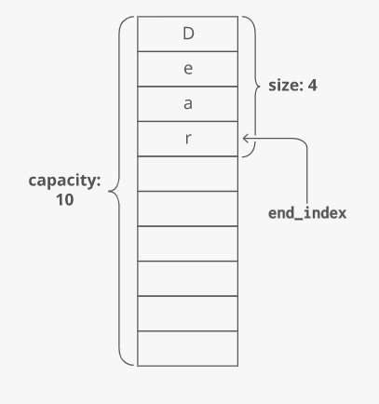
Size vs. Capacity

Slide 9
APPROACH
When we enter an element in array but array is full then you create a function, this function creates a new array double size or as you wish and copy all element from the previous array to a new array and return this new array. Also, we can reduce the size of the array. and add an element at a given position, remove the element at the end default and at the position also.

Slide 10
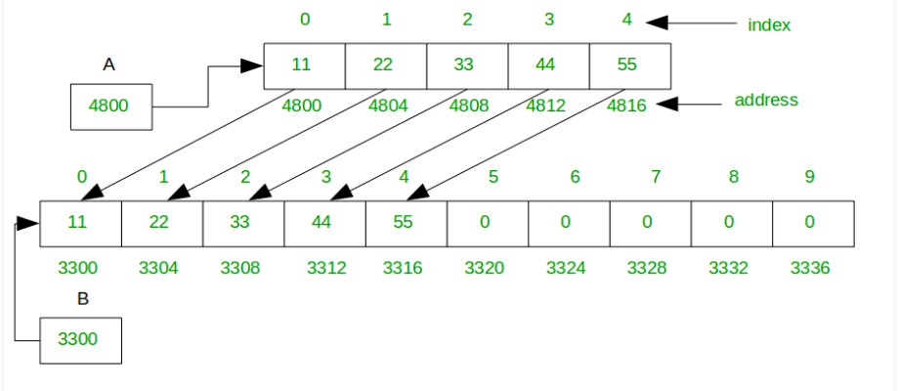
Add Element

Slide 11
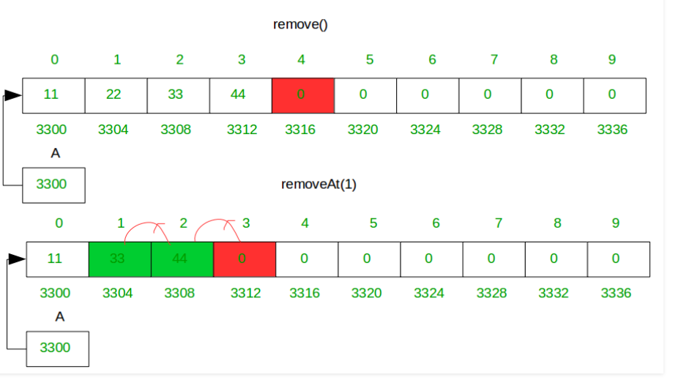
DELETE ELEMENT

Slide 12
REFERENCES
https://www.interviewcake.com/concept/java/dynamic-array

Slide 13
Queries??

